Slide 1
SEMANTICALLY-GUIDED IMAGE COMPRESSION FOR ENHANCED PERCEPTUAL QUALITY AT EXTREMELY LOW BITRATES
Based on the paper by Shoma Iwai, Tomo Miyazaki, and Shinichiro Omachi
PRESENTED BY
ARUN GEORGE
CSE S7 19
PTA21CS020
NO : 22

Slide 2
INTRODUCTION
Importance of Lossy Image Compression:
Efficient image storage and transmission.
Traditional methods rely on handcrafted algorithms.
Traditional methods: JPEG, BPG, VVC.
Emergence of Neural-Network-Based Methods:
Leveraging deep learning for improved rate-distortion performance.
Encoder-decoder architectures optimized using large datasets.
Challenge in Low-Bitrate Compression:
Difficulty in maintaining perceptual quality at bitrates below 0.1 bpp.
Existing models struggle with blurring and unnatural textures.
Proposed Solution:
A GAN-based model that utilizes semantic label maps for texture synthesis.
Achieves perceptually pleasing images even at extremely low bitrates.

Slide 3
LITERATURE SURVEY
J. Ballé, V. Laparra, and E. P. Simoncelli, "End-to-end optimized image compression," ICLR, 2017.
End-to-end approach for image compression.
Learning optimal compression and reconstruction simultaneously.
Improvements in rate-distortion performance over traditional methods.
J. Ball, D. Minnen, S. Singh, S. J. Hwang, and N. Johnston, "Variational image compression with a scale hyperprior," ICLR, 2018.
Proposed a variational framework for image compression incorporating a scale hyperprior.
Enabled better modeling of the probability distribution of latent representations.
Achieved enhanced compression performance through the use of hyperprior information.
D. Minnen et al., "Joint autoregressive and hierarchical priors for learned image compression," NeurIPS, 2018.
Developed a compression method combining autoregressive and hierarchical priors.
Improved the modeling of dependencies in latent representations, enhancing compression efficiency.
Outperformed previous state-of-the-art models in terms of both compression rate and image quality.

Slide 4
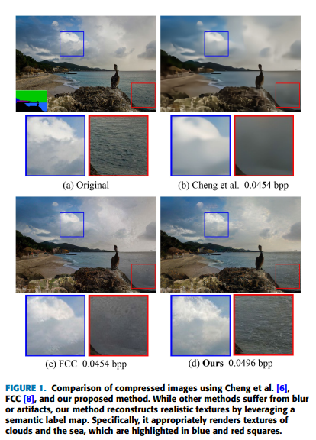
MOTIVATION AND BACKGROUND
Need for Improved Image Quality:
Performance of existing methods.
Limitations in reconstructing natural textures

Slide 5
Proposed Method
Semantically-Guided Image Compression Method
Utilizes semantic information to enhance image quality.
Incorporates semantic label maps in the decoding process.

Slide 6
RELATED WORKS
LEARNED IMAGE COMPRESSION
GAN-BASED IMAGE COMPRESSION
SEMANTIC GUIDED IMAGE COMPRESSION

Slide 7
KEY CONTRIBUTIONS
Noval approach
Semantic label map for texture reconstruction.
New compression strategies for label maps:
Downscaling
Reducing number of classes
Autoregressive compression

Slide 8
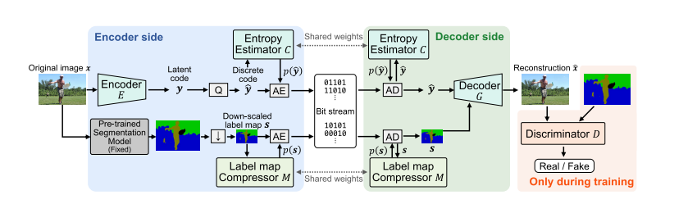
METHODLOGY
Architecture of the Proposed Mode
Encoder: Extracts latent code from the image.
Label Map Compression: Compresses semantic label maps effectively.
Decoder: Reconstructs the image using latent code and label maps.
Discriminator: Enhances perceptual quality using GAN-based training.

Slide 9

METHODOLOGY
Encoder:
original image x ∈ R H×W×3→ latent code y ∈ R H/16×W/16×Cy
additive uniform noise during training and use the actual quantization during inference

Slide 10



METHODOLOGY
Entropy Estimator:

Slide 11

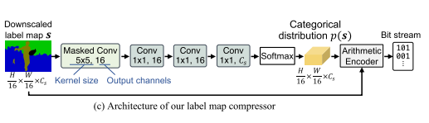
METHODOLOGY
Label Map Compressor
downscale the semantic label map to H /16 × W/ 16 .
reduce the number of classes in the label maps.

Slide 12
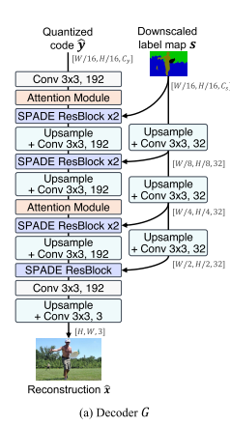
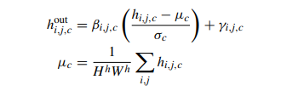
METHODOLOGY
Decoder:
Each SPADE residual block consists of two convolution layers and two SPADE layers
SPADE layer: input intermediate feature map h ∈ R H h×Wh×C h →modulated feature map h out ∈ R H h×Wh×C h using the input semantic label maps

Slide 13
METHODOLOGY
Discriminator:
learns to distinguish real images x from reconstructions xˆ
takes a corresponding semantic label map s as well as the real or fake image as inputs

Slide 14
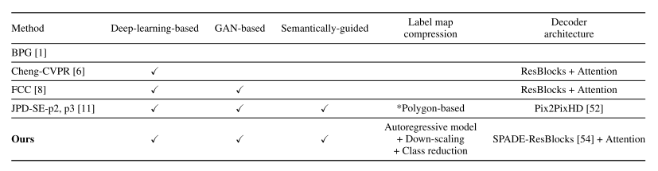
RESULT AND EVALUATION

Slide 15
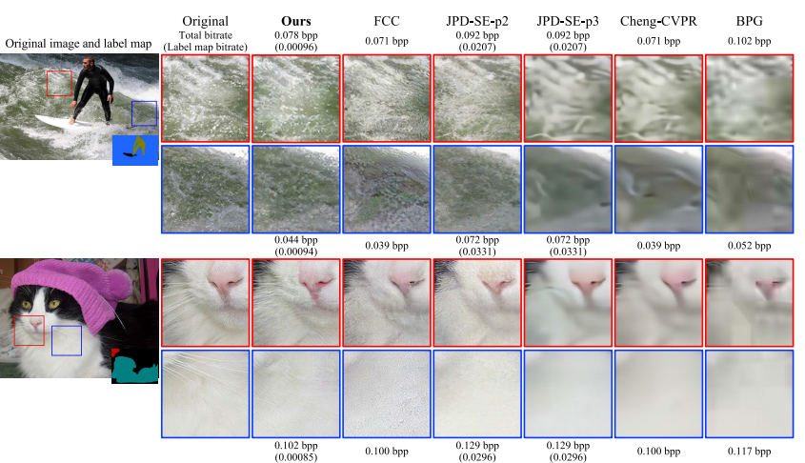
RESULT AND EVALUATION

Slide 16
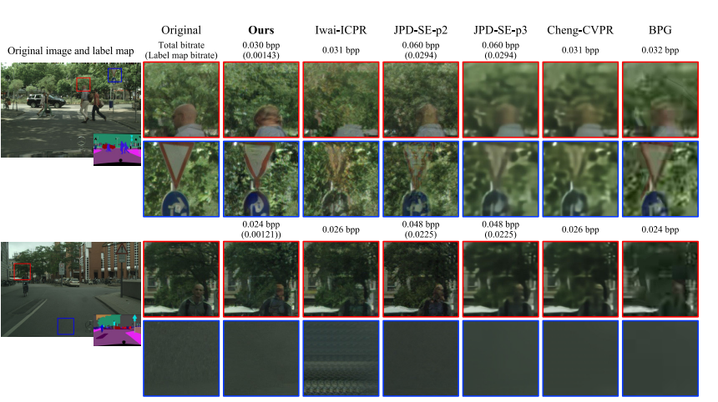
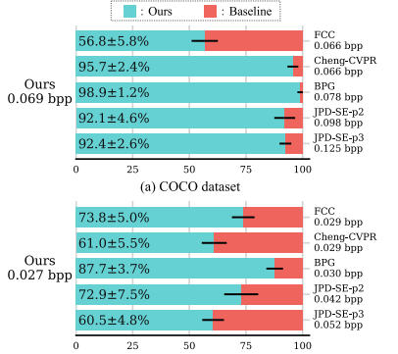
RESULT AND EVALUATION

Slide 17
EXPERIMENTAL RESULTS
Datasets used→COCO and Cityscapes
Key findings:
Improved quality and realism of reconstructed images.
Efficiency of label map compression strategies.
Reduced data size and improved perceptual quality.

Slide 18
CONCLUSION
Summary of Contributions:
Innovative use of semantic information in image compression. Effective compression strategies for low-bit-rate settings.
Future Work:
Potential improvements and applications.

Slide 19
REFERENCES
[1] F. Bellard. (2014). BPG Image Format. [Online]. Available: https://bellard.org/bpg/
[2] B. Bross, Y.-K. Wang, Y. Ye, S. Liu, J. Chen, G. J. Sullivan, and J.-R. Ohm, ‘‘Overview of the versatile video coding (VVC) standard and its applications,’’ IEEE Trans. Circuits Syst. Video Technol., vol. 31, no. 10, pp. 3736–3764, Oct. 2021.
[3] R. Wang, Z. Sun, and S.-I. Kamata, ‘‘Adaptive image compression using GAN based semantic-perceptual residual compensation,’’ in Proc. 25th Int. Conf. Pattern Recognit. (ICPR), Jan. 2021, pp. 9030–9037.
[4] E. Agustsson, M. Tschannen, F. Mentzer, R. Timofte, and L. Van Gool, ‘‘Generative adversarial networks for extreme learned image compression,’’ in Proc. IEEE/CVF Int. Conf. Comput. Vis. (ICCV), Oct. 2019, pp. 221–231.
[5] S. Duan, H. Chen, and J. Gu, ‘‘JPD-SE: High-level semantics for joint perception-distortion enhancement in image compression,’’ IEEE Trans. Image Process., vol. 31, pp. 4405–4416, 2022.
[6] J. Chang, Z. Zhao, L. Yang, C. Jia, J. Zhang, and S. Ma, ‘‘Thousand to one: Semantic prior modeling for conceptual coding,’’ in Proc. IEEE Int. Conf. Multimedia Expo (ICME), Jul. 2021, pp. 1–6.

Slide 20
THANK YOU

